Slide 1

Discussion On Git Tools
By Alex Howson

Slide 2
Today Is Just a Discussion…
Please keep to tortoise git for now.

Slide 3
First Principles Thinking
As developers I think it is important that we sometimes take a step back and assess how we do things
When thinking about how to improve it can be a good exercise to think about the start and how you would go about things differently
I have had one such thought around our git tools

Slide 4
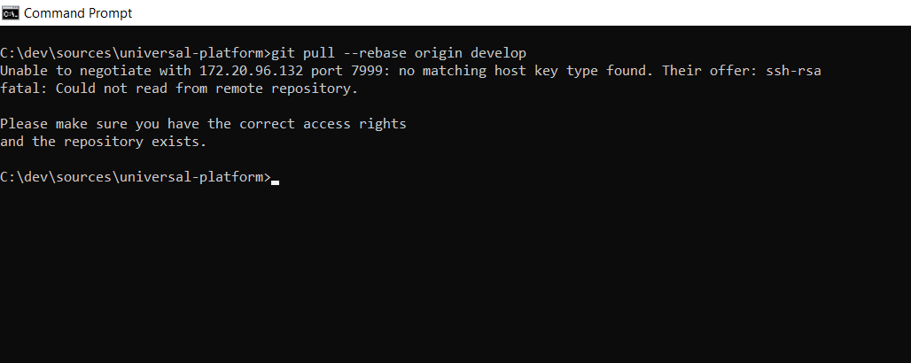
Discovery
Normally if you try to use alternatives to tortoise git it doesn’t work; you’ll get the following error message.

Slide 5
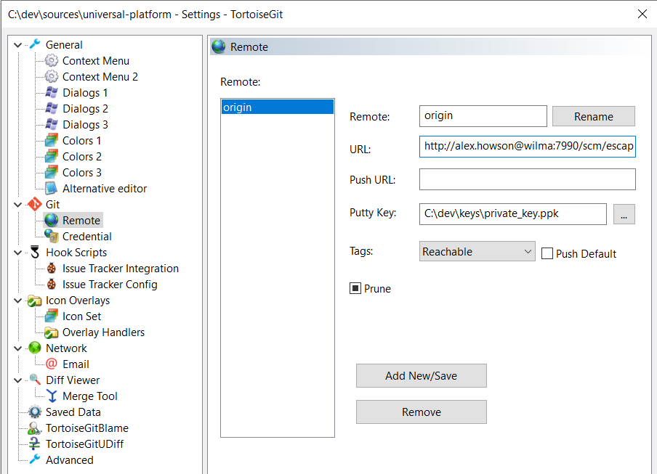
Discovery
So, to fix this we can switch the origin of the branch over to using HTTP instead of SSH.

Slide 6
The Candidates
Git on the command line
Github Desktop
Visual Studio 2022 “Git Changes”
Tortoise Git

Slide 7
The Flood Gates are Open!
But can we hold back the tide?

Slide 8
Candidate #1 Tortoise Git
The safe known quantity
Main advantages: Familiarity, Plinky SSH Support, Context menus in file explorer
Main disadvantages: Convoluted UI, Complicated setup process for SSH, Unclear options when executing git commands that can lead to mistakes

Slide 9
Candidate #2 Github Desktop
The simple but effective tool
Main advantages: Simple to use, Easy to setup, Good shortcuts
Main disadvantages: Some options are a little hidden and unclear, hints towards github integration but not required, provides no easy UI git configuration options, pushes towards text editors rather than VS2022

Slide 10
Candidate #3 Git Command Line
The powerful accurate and precise original
Main Advantages: Aliases, Simple setup, precise and accurate git commands
Main Disadvantages: Difficult initial learning curve, some commands are complex to use from the command line, No warnings on dangerous commands (--force is dangerous if used incorrectly)

Slide 11
Candidate #4 Visual Studio 2022
Self-contained within the IDE
Main advantages: Integrated within the development environment, has the core functionality, accessible by the shortcut of “ctrl + 0, ctrl + g” for the “git changes” panel
Main disadvantages: Lacks specific git commands for feature branching workflow, lacks shortcuts (possibly assignable), UI is compacted onto a panel meaning small buttons for key git operations that are hard to click

Slide 12
Discussion

